Slide 1

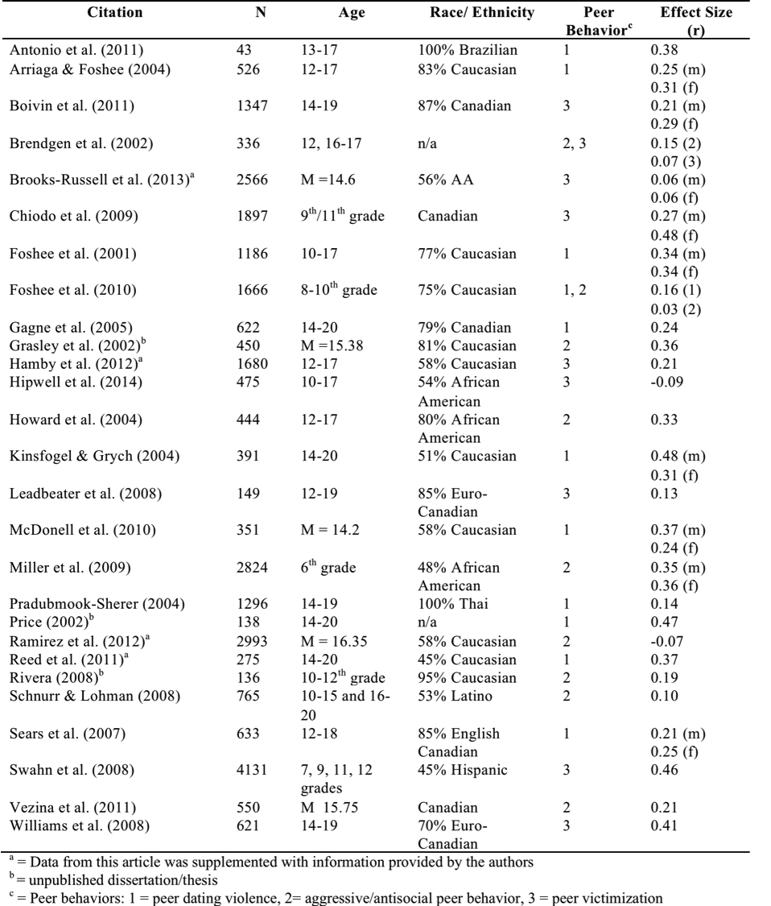

A Meta-Analytic Review of the Role of Peers in
Adolescent Dating Violence
Rachel C. Garthe, M.S., Terri Sullivan, Ph.D., & Michael A. McDaniel, Ph.D.
Introduction
Moderation analyses revealed a few differential effects by how studies presented analyses by sex and by how studies sampled adolescents.
Stronger effect sizes in samples that presented separate statistics by sex and in samples that included adolescents who dated at any point (versus those who were only currently dating).
Dating violence is of high prevalence among adolescents, and it is associated with negative health and developmental outcomes, making it a national public health concern.
The literature and prevalence statistics on adolescent dating violence is a relatively new area of research, gaining more attention in the past decade. One of the risk factors that has been highlighted in the literature is the influence of peers:
Peers involved in dating violence
Peer aggression and antisocial behaviors
Peer victimization
Grounded in theory:
Social Learning Theory
Homophily
Social Augmentation Hypothesis
Due to the variety of peer influences and the evolving literature in adolescent dating violence, a meta-analytic review of peer influences is essential in moving the field forward.
The effect size for the relation between peer dating violence and individuals’ dating violence was significant (r = 0.30, 95% CI = 0.24, 0.35) in a heterogeneous set of studies (Q = 81.02). The effects size for the relation between aggressive/antisocial peer behaviors and dating violence was significant (r = 0.20, 95% CI = 0.08, 0.32) in a heterogeneous set of studies (Q = 350.10). Finally, the effect size for the relation between peer victimization and dating violence was significant (r = 0.23, 95% CI = 0.12, 0.34) in a heterogeneous set of studies (Q = 488.34).
Results
Results, cont.
Discussion
All three of the peer influences were significantly associated with adolescent dating violence, providing support that peers are major socialization agents during adolescence.
A multitude of peer influences may contribute to adolescent dating violence
The current study provided a greatly needed synthesis of the literature on peer influences and adolescent dating violence
Inform existing dating violence prevention programs: peers need to be included
A search for articles relevant to the meta-analysis was conducted by searching electronic databases, manually examining online journal databases, checking reference lists of relevant articles, and searching unpublished dissertations. Across the meta-analyses within this study, a total of 27 articles and papers were used, including 28,491 adolescents of diverse backgrounds.
Three separate meta-analyses were run for 1) peer dating violence, 2) antisocial/aggressive peer behaviors, and 3) peer victimization.
Methods
References available upon request.
Author contact information:
Rachel Garthe
Department of Psychology, VCU
810 West Franklin Street, office 304
Richmond, VA 23284

